Slide 1
GO Team Business Meeting #2
Where we are – Where we’re going

Slide 2
Where We Are
Our strategic plan is the guide for the work we’re doing in the school. By monitoring the plan and ranking priorities, we can all work towards the common goals. Using the priorities in the strategic plan, the school leadership team developed a Continuous Improvement Plan (CIP) for the current school year.

Slide 3
Timeline for GO Teams
You are HERE
Fall 2021
GO Team Developed 2021-2025 Strategic Plan
1
Summer 2023
School Leadership completed Needs Assessment and defined overarching needs for SY22-23
2
August 2023
School Leadership completed 2023-2024 Continuous Improvement Plan
3
Sept. – Dec. 2023
Utilizing current data, the GO Team will review & possibly update the school strategic priorities and plan
4
Before Winter Break
GO Team will take action (vote) on the rank of the strategic plan priorities for SY24-25 in preparation for budget discussions.
5

Slide 4
Discussion Items
Current Strategic Plan
Continuous Improvement Plan
Needs Assessment
SMART GOALS
Action Plan
Strategic Plan Alignment & Update
MAP Data
Data Protocol

Slide 5
Current Strategic Plan
2021-2025

Slide 6
West Manor IB World School
SMART Goals
Increase the % of grades 3-5 students scoring proficient or above on Milestones/ MAP in reading by 3%
Increase the % of grades 3-5 students scoring proficient or above on Milestones/MAP in math by 3%
Increase the percentage of students with 10 or less absences by 3%
APS Strategic Priorities & Initiatives
School Strategic Priorities
School Strategies
Fostering Academic Excellence for All
Data
Curriculum & Instruction
Signature Program
1.
3.
1A. Implementation of an intervention block to reduce gaps in learning
1B. Employ a literacy block with phonics for grades k-2
1C. Create PLC planning time for teachers to internalize standards and plan for instruction
Increase student phonic awareness and create early readers
Increase student knowledge in numbers and operations domain
Increase student multiplication skills
Building a Culture of Student Support
Whole Child & Intervention
Personalized Learning
Increase student attendance and decrease suspension rate
TBD: Create an attendance team to monitor and address attendance concerns, Create a Care Team to address student needs
TBD: Utilize SLC practices and restorative justice with the Counselor to reduce suspensions
Equipping & Empowering Leaders & Staff
Strategic Staff Support
Equitable Resource Allocation
Increasing Teacher knowledge of Standards
Increase Teacher knowledge of IB Program
TBD: Monthly IB training for staff, Professional development individualized around teacher needs in reading and math, training for phonics program (Fundations)
Ongoing PD for SEL, restorative practices, and trauma
Creating a System of School Support
Collective Action, Engagement & Empowerment
TBD: Conduct data meetings in PLC, with parents and students. Students will also have goal setting meetings with teachers
--Increase Parent Liaison and Social Worker positions to full time to support the needs of students and parents
Improve stakeholder knowledge of school data and how to assist
Provide support to students and stakeholders in need

Slide 7
Continuous Improvement Plan

Slide 8
West
School Name
** Strengths Challenges
IB Authorized School 36% Proficient on ELA Milestones
School climate (Attendance Rate 95% ) 29% Proficient on Math Milestones English Language Learners Performance New Math Standard Implementation Math increase of 12.4% on Milestones Low Parent Engagement
Our Overarching Needs
Literacy: Increase student knowledge of phonics and phonemic awareness to support early readers. Improve student writing in all genres
Numeracy: Teachers need to internalize new Math standards in efforts to increase student achievement.
Whole Child & Intervention: Parents need to partner with the school to assist the scholars with assignments and to attend school regularly Literacy Problem Statement
Notes:
Notes for School CIP Teams: After completing your Comprehensive Needs Assessment ( data protocol), you will come here and identify some strengths and opportunities/challenges you have observed from the data. The priority areas are Literacy, Numeracy, and Whole Child & Student Support. Identify an overarching need for each area. Formulate a problem statement for each area. Make sure the problem statement meets the criteria. Refer to your CIP resources.

Slide 9
West Manor goals
Increase the % of grades 3-5 students scoring proficient or above on Milestones from 36% to 39%
Increase the % of grades 3-5 students scoring proficient or above on Milestones from 29% to 32%
Parent participation will assist in raising the average daily attendance for 95 to 96% and reduce the number of disciplinary infractions to 235

Slide 10
West Manor Action Plans
ELA
Math
Whole Child
Provide realtime feedback and coaching to teachers scoring emergent in small group reading implementation, and writing
Continue Gifted Collab modelproviding inquiry based instruction to all classes
Create additional 45 minute planing period for Math prework and data analysis
SELT will begin supporting DSE Teachers in PLC in addition to grade level PLC
Attendance Team with weekly meetings
Whole Child Intervention Team with Weekly meetings
Continue Response to Intervention Specialist

Slide 11
GO Team Activity & Discussion
GO TEAM DISCUSSION: Review the priorities and goals in your strategic plan and the information and goals CIP. Reflect on if updates need to be made to the Strategic Plan.
Are all CIP Goals reflected in
our Strategic Plan Priorities?
If not, which CIP Goal(s) are missing and should be added to the Strategic Plan?

Slide 12
Updates to the
Strategic Plan
No changes to Strategic Plan
1.Increase student phonic awareness and create early readers
2 Increase student knowledge in numbers and operations domain
3. Increase student multiplication skills
4. Increase student attendance and decrease suspension rate
5.Increasing Teacher knowledge of Standards
Increase Teacher knowledge of IB Program
7. Improve stakeholder knowledge of school data and how to assist
9. Provide support to students and stakeholders in need

Slide 13
MAP Data

Slide 14
Spring MAP Results
Before Presenting to your GO Team:
Insert School’s 2023 Spring MAP Results – use as many slides as necessary

Slide 15
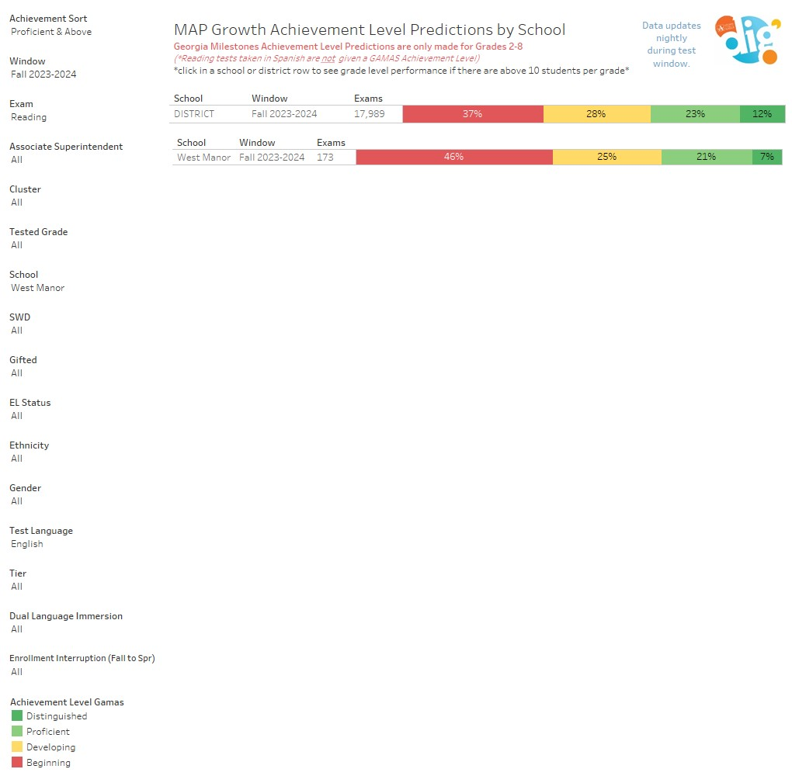
Fall MAP Results

Slide 16
Fall MAP Results Math

Slide 17
GO Team Discussion: Data Protocol
What do you notice?
What are your wonderings?
What additional questions do you have?

Slide 18
Strategic planning will help you fully uncover your available options, set priorities for them, and define the methods to achieve them.
Robert J. Mckain

Slide 19
Where we’re going
At our next meeting(s) we will discuss how our data is aligning to our strategic plan and determine if we need to make any adjustments.
Before the end of Fall Semester, we will take Action (vote) on ranking our strategic priorities for the 2024-2025 school year.
Let me or the Chair know of any additional information you need for our future discussion.

Slide 20
Thank you

